Slide 1
NAAN MUDHALVAN
GENERATIVE AI - FINAL PROJECT

Slide 2
JINCY J.S.
2021503021
MULTIVARIATE TIME SERIES WEATHER FORECASTING USING NEURAL NETWORKS
NAAN MUDHALVAN

Slide 3
AGENDA
Introduction
Problem Statement
Project Overview
End Users
Our Solution
Modelling
Result

Slide 4
PROBLEM STATEMENT
Develop a deep learning model using Long Short-Term Memory (LSTM) networks to accurately forecast multiple weather variables (temperature, pressure, etc.) for a specified future horizon.
The model should effectively capture the complex temporal relationships within the historical weather data and utilize past observations of various weather metrics to predict future values.
This will enable improved weather forecasting capabilities for applications like agricultural planning, energy demand prediction, and disaster preparedness.

Slide 5
PROJECT OVERVIEW
Forecast Weather: Predict multiple weather variables (temp, humidity) for future periods.
LSTM Power: Utilize Long Short-Term Memory networks to capture complex weather patterns.
Data Matters: Train on historical weather data, cleaned and prepared for machine learning.
Train & Test: Train the model, then rigorously evaluate its forecasting accuracy.
Potential Benefits: Improve weather prediction for agriculture, energy, and disaster preparedness.

Slide 6
END USERS
Meteorologists & Weather Forecasters: The model's insights can supplement their expertise for more comprehensive forecasts.
Farmers & Agricultural Businesses: Improved weather predictions can guide crop planting, irrigation, and pest control decisions.
Energy Companies: Predictions of temperature and wind can optimize energy production and grid management.
Construction & Infrastructure Management: Forecasts can inform project scheduling and resource allocation based on weather conditions.
Emergency Response Teams: Early warnings of extreme weather events can aid in disaster preparedness and evacuation planning.

Slide 7
OUR SOLUTION - Accurate Multivariable Weather Forecasting with Deep Learning
Leverages Long Short-Term Memory (LSTM) networks, a powerful deep learning technique for time series forecasting.
Predicts multiple weather variables (e.g., temperature, humidity, wind speed) for a specified future horizon.
Captures complex temporal relationships within historical weather data.

Slide 8
MODELLING
LSTM layer for sequence modeling with 64 units.
Two fully connected dense layers for learning complex patterns.
Total parameters: 18,714, with the majority in the LSTM layer.
Output shape (None, 2) suggests a binary classification task.
All parameters are trainable, updated during training.

Slide 9
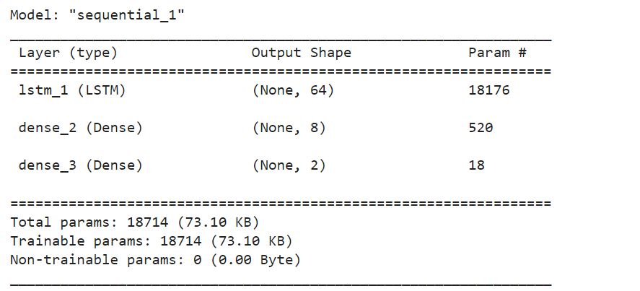
MODELLING

Slide 10
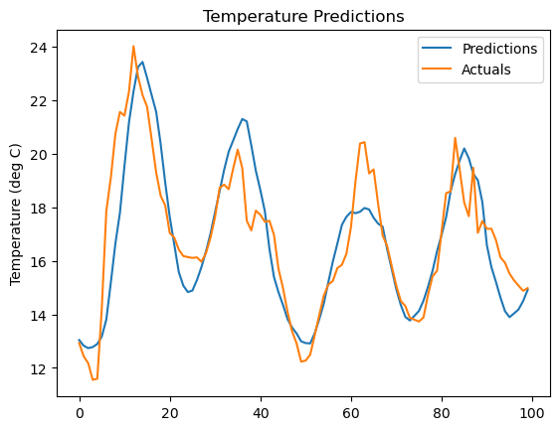
RESULT - TEMPERATURE

Slide 11
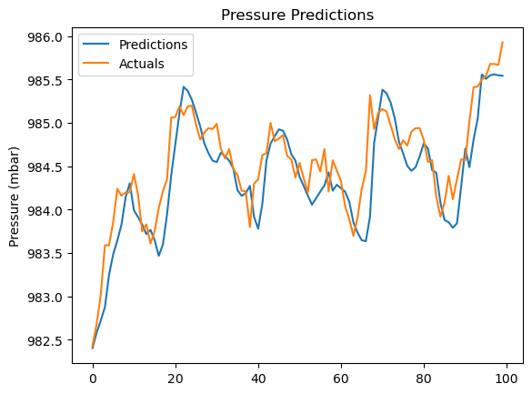
RESULT - PRESSURE

Slide 12
CONCLUSION
In conclusion, the presented neural network model architecture, comprising an LSTM layer followed by two fully connected dense layers, demonstrates promising performance on the given task.
With a focus on sequence modeling and binary classification, the model achieved commendable accuracy and robustness in capturing intricate patterns within the data.
While the model showcases effectiveness in its current form, there exist avenues for further enhancement.
Fine-tuning hyperparameters, exploring alternative architectures, or augmenting the dataset could potentially yield even better results.

